Slide 1
Architecting Intelligence: The Evolution of AI Agents in Enterprise Strategy
AI agents transform enterprise strategy, enhancing processes, decision-making, and customer engagement. This explores the AI maturity landscape, architectural considerations, and implementation frameworks to harness AI for digital transformation.
Praveen Govindaraj
Lead AI Engineer , Singtel

Slide 2

About me
📊 Lead AI Engineer in Singtel
Over 15 years of experience in AI , Data Science & analytics domain.
🚀 Expertise Areas:
Customer Analytics, Anti-Money Laundering/Counter-Terrorism Financing
(AML/CFT), Credit Risk Modelling, Data Warehousing & GenAI Platforms.
📉 Achievements:
AI Strategy and Operationalize AI CoE at enterprise
Reduced Customer Churn, Streamlined Processes, Enhanced Business performance.
💡 Proven Record:
Delivering data-driven business improvements & GenAI platform.
Hobbies: Playing Piano 🎹 & Violin🎻.
💻 Contributions: Open Source Projects in GenAI. Falcon-evaluate
✍️ Interests: Tech Blogging.
📚 Leisure: Reading Books.

Slide 3
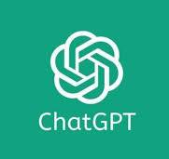

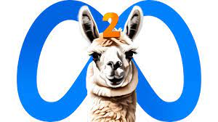

What is LLM ?
An LLM, or Large Language Model, is like a super-smart writing assistant. It learns from a massive amount of text to understand and mimic human language. This lets it answer questions, write stories, and more, just by analysing the words you give it.

Slide 4
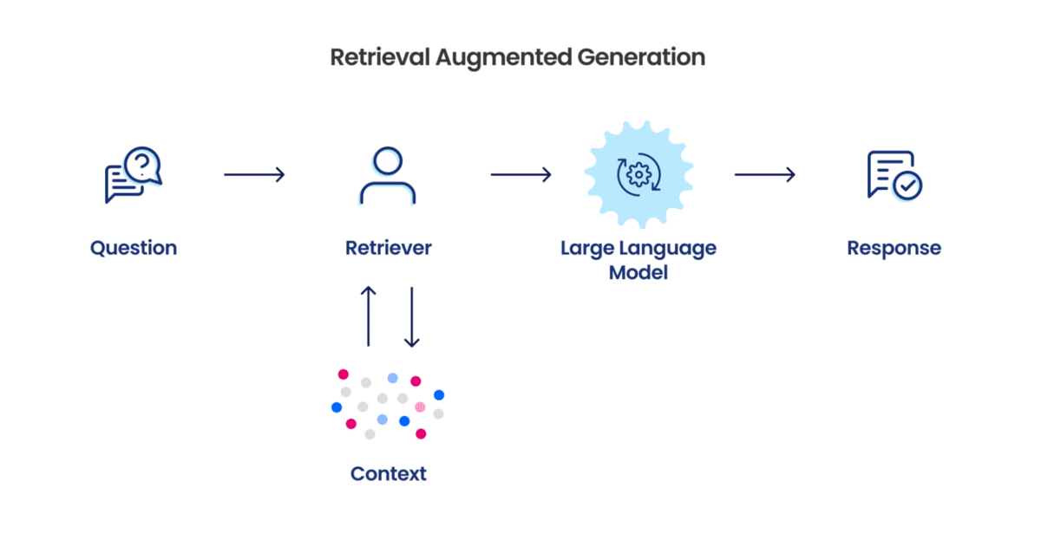
What is RAG ?
RAG, or Retrieval-Augmented Generation, is like a smart assistant that first finds relevant info from a big database, then uses it to craft detailed answers.
It combines quick research with creative writing, providing informed and engaging responses.

Slide 5
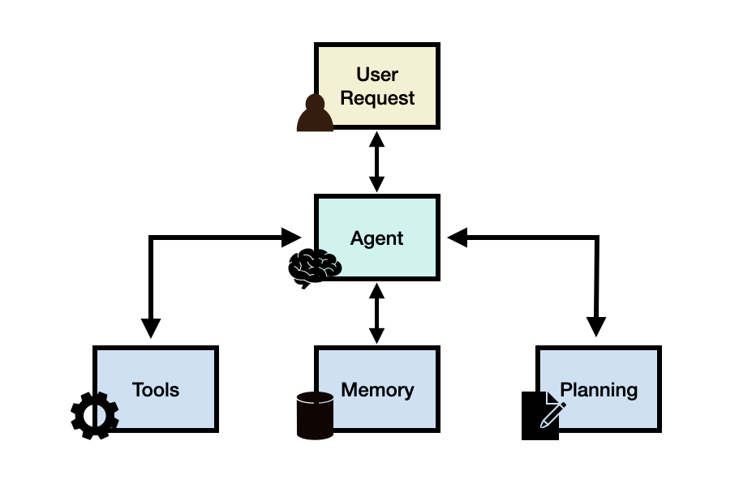
What is LLM Agent ?
Very smart digital assistants that can write text, answer questions, and even create stories or solve problems by learning from vast amounts of information on the internet via API calls and works well with other software tools

Slide 6
CHALLENGES OF SILOSED IMPLEMENTATION
Road to robust LLM Agentic systems
1
LLM Alone Workflows
Lack of fact fullness led to hallucination.
Bias
SOLUTION 01
LLM with relevant context information helps to mitigate the hallucination.
2
RAG workflows
Good at sharing the relevant answer to question.
Lacks recent information and connectivity. information.
SOLUTION 02
Equipped with tools and connectivity to internet and intranet to get the relevant information via API.
3
LLM Agent
Complex system integration
Quite hard to validate accuracy due to complex integration
SOLUTION 03
Ensure individual components are validated and tested as whole system.

Slide 7
Confluence of LLM , RAG and Agent
Collaborative Intelligence LLM,RAG and Agent Integration
LLM
Large Language Models good at generate relevant response for prompts , It has ability to reason & reflect
LLM
RAG
AGENT
RAG
AGENT
Empower LLM with more relevant context to mitigate hallucination
It has tools , memory and planning ability coordinate plan and execute things get done

Slide 8







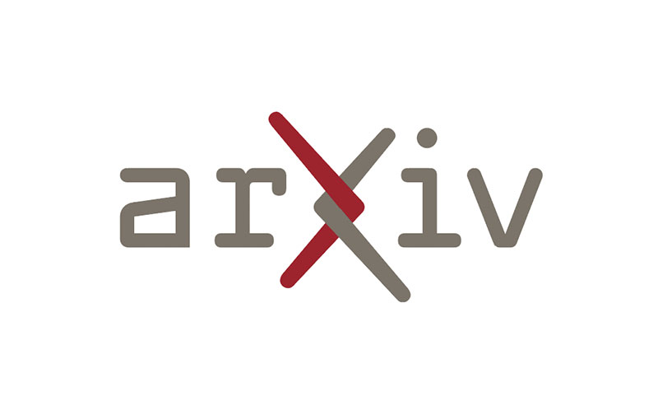






Typical LLM Agent
User Input
Semantic search DB
Tool Input
Fetch History
Memory
Write History
API Tool
Reasoning Agent
Conversation History
Tool Output

Slide 9
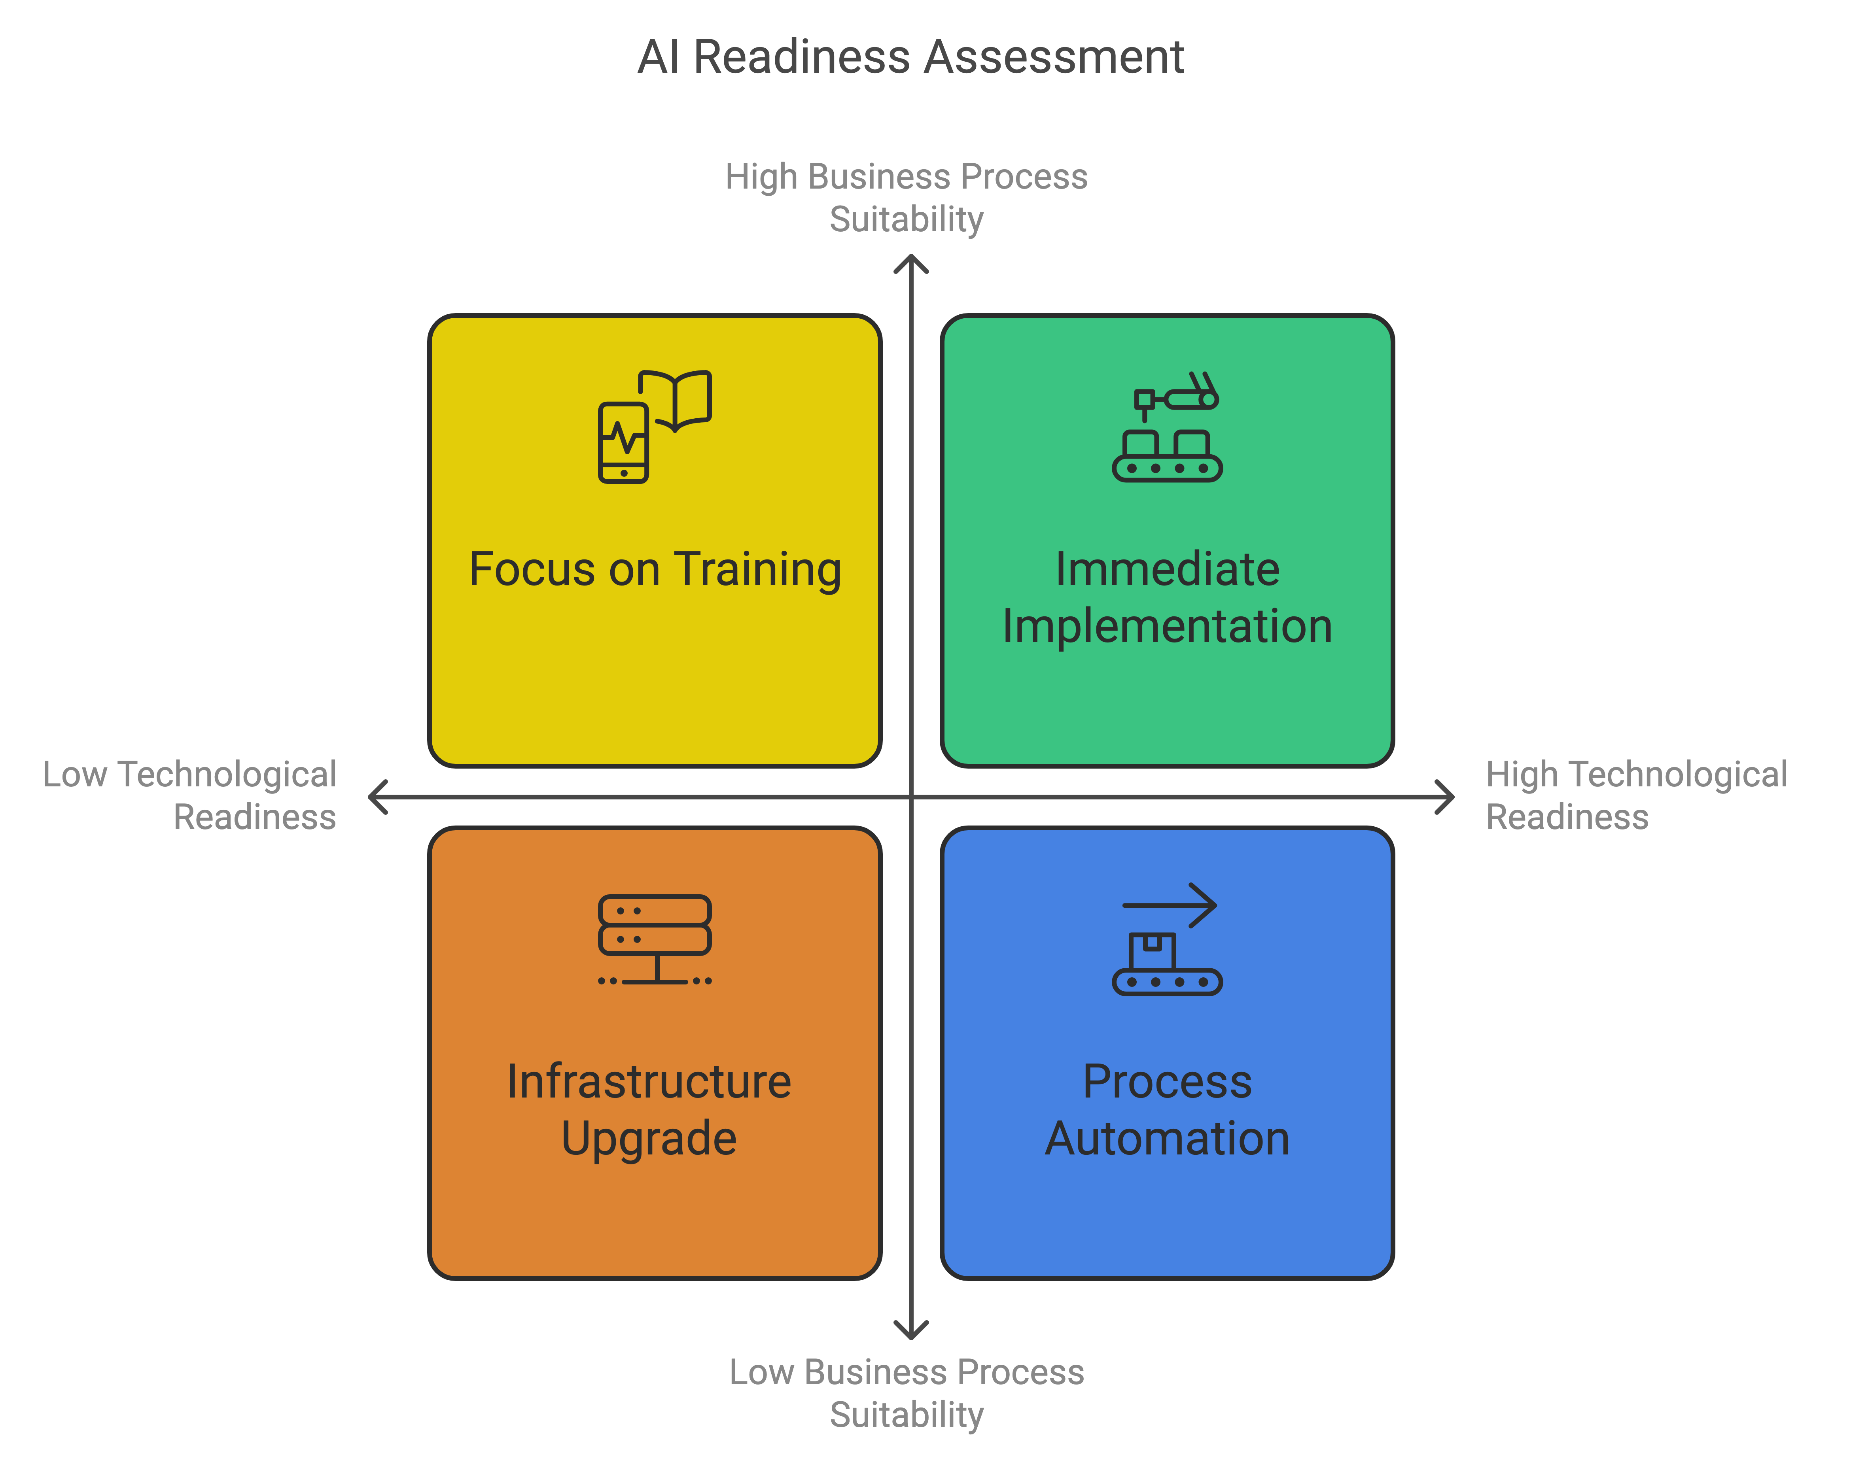
Assessment Quadrant

Slide 10
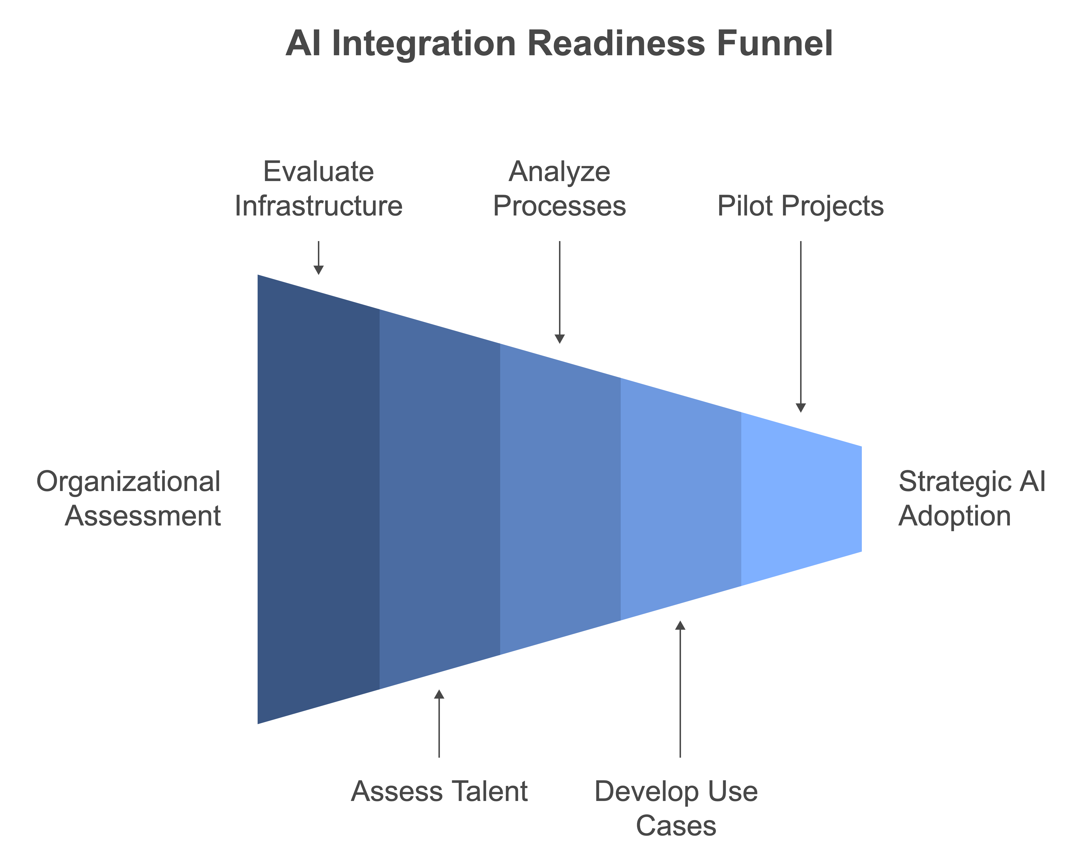
Assessing Organizational Readiness for AI Integration
Notes:
Assessing your organization's readiness for AI agent integration involves evaluating both technological infrastructure and AI capability maturity, as well as identifying business processes that could benefit from AI implementation. Here's a structured approach to guide you through this assessment:
1. Evaluate Technological Infrastructure and AI Capability Maturity
Data Infrastructure: Examine the quality, accessibility, and volume of your organization's data. Assess data management practices, governance frameworks, and the integration of disparate data sources to ensure a robust, AI-ready data ecosystem.
Technology Stack: Assess the compatibility of your existing IT infrastructure with AI tools and platforms. This includes evaluating computational power, storage capacity, and network capabilities required to support AI workloads.
Talent and Skills: Evaluate the technical proficiency of your employees in areas such as data science, machine learning, and AI development. Identify gaps and consider targeted training programs or hiring skilled professionals to build a capable AI workforce.
Governance and Culture: Assess your organization's data governance policies, ethical considerations, and overall culture towards AI adoption. Ensure that there are clear guidelines and a supportive environment for AI initiatives.
2. Identify Business Processes for AI Agent Integration
Process Analysis: Conduct a thorough analysis of existing business processes to identify repetitive, time-consuming, or error-prone tasks that could benefit from automation. Look for areas where AI agents can enhance efficiency, accuracy, or decision-making.
Use Case Development: Develop specific use cases where AI agents can be applied. This could include customer service automation, data analysis, predictive maintenance, or personalized marketing strategies.
Pilot Projects: Start with pilot projects to test the integration of AI agents in selected processes. Monitor performance, gather feedback, and make necessary adjustments before scaling up.
3. Utilize AI Readiness Assessment Tools
Leverage available AI readiness assessment tools to gain a comprehensive understanding of your organization's preparedness:
Cisco AI Readiness Assessment: Evaluates readiness across six areas: strategy, infrastructure, data, talent, governance, and culture.
Cisco
Avanade AI Readiness Assessment Framework: Assesses progression through five stages of AI readiness and identifies practical actions to drive business value with AI.
Avanade
MITRE AI Maturity Model: Provides a structured approach to assess AI maturity and offers guidance for improvement.
MITRE
By systematically evaluating these aspects, your organization can develop a clear roadmap for integrating AI agents into business processes, ensuring a strategic and effective adoption of AI technologies.

Slide 11
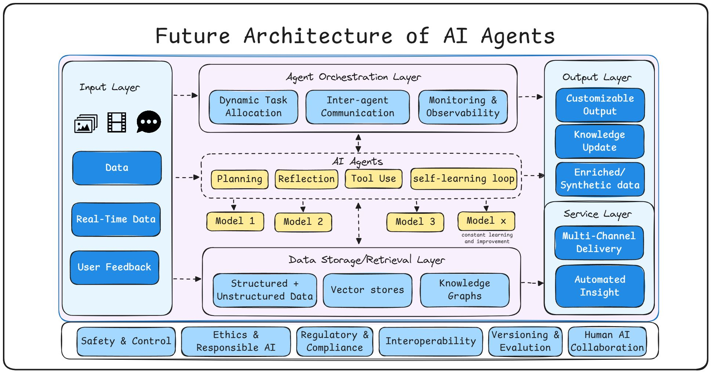
Typical LLM Agent
Notes:
1️⃣ Input Layer Sophistication: - Multimodal data processing (images, video, text) - Real-time data integration capabilities - Dynamic user feedback loops - Adaptive data handling mechanisms 2️⃣ Agent Orchestration Excellence: - Dynamic task allocation for optimal resource usage - Sophisticated inter-agent communication protocols - Advanced monitoring and observability features - Real-time performance optimization 3️⃣ AI Agents Core Capabilities: - Strategic planning and decision-making - Self-reflection and improvement mechanisms - Intelligent tool selection and utilization - Continuous learning loops for perpetual enhancement - Multiple specialized models working in harmony (Model 1 .. Model X) 4️⃣ Data Architecture Innovation: - Unified storage for structured and unstructured data - Advanced vector stores for efficient retrieval - Knowledge graphs for complex relationship mapping - Scalable and adaptable data management 5️⃣ Output Layer Sophistication: - Customizable output formats - Multi-channel delivery systems - Automated insight generation - Adaptive response mechanisms 📌 What truly sets this architecture apart is its focus on: 1. Safety & Control: Ensuring reliable and secure operations 2. Ethics & Responsible AI: Building trust through ethical principles 3. Regulatory Compliance: Futureproofing against evolving regulations 4. Interoperability: Seamless integration capabilities 5. Versioning & Evolution: Systematic improvement tracking 6. Human-AI Collaboration: Maintaining human-centric development

Slide 12
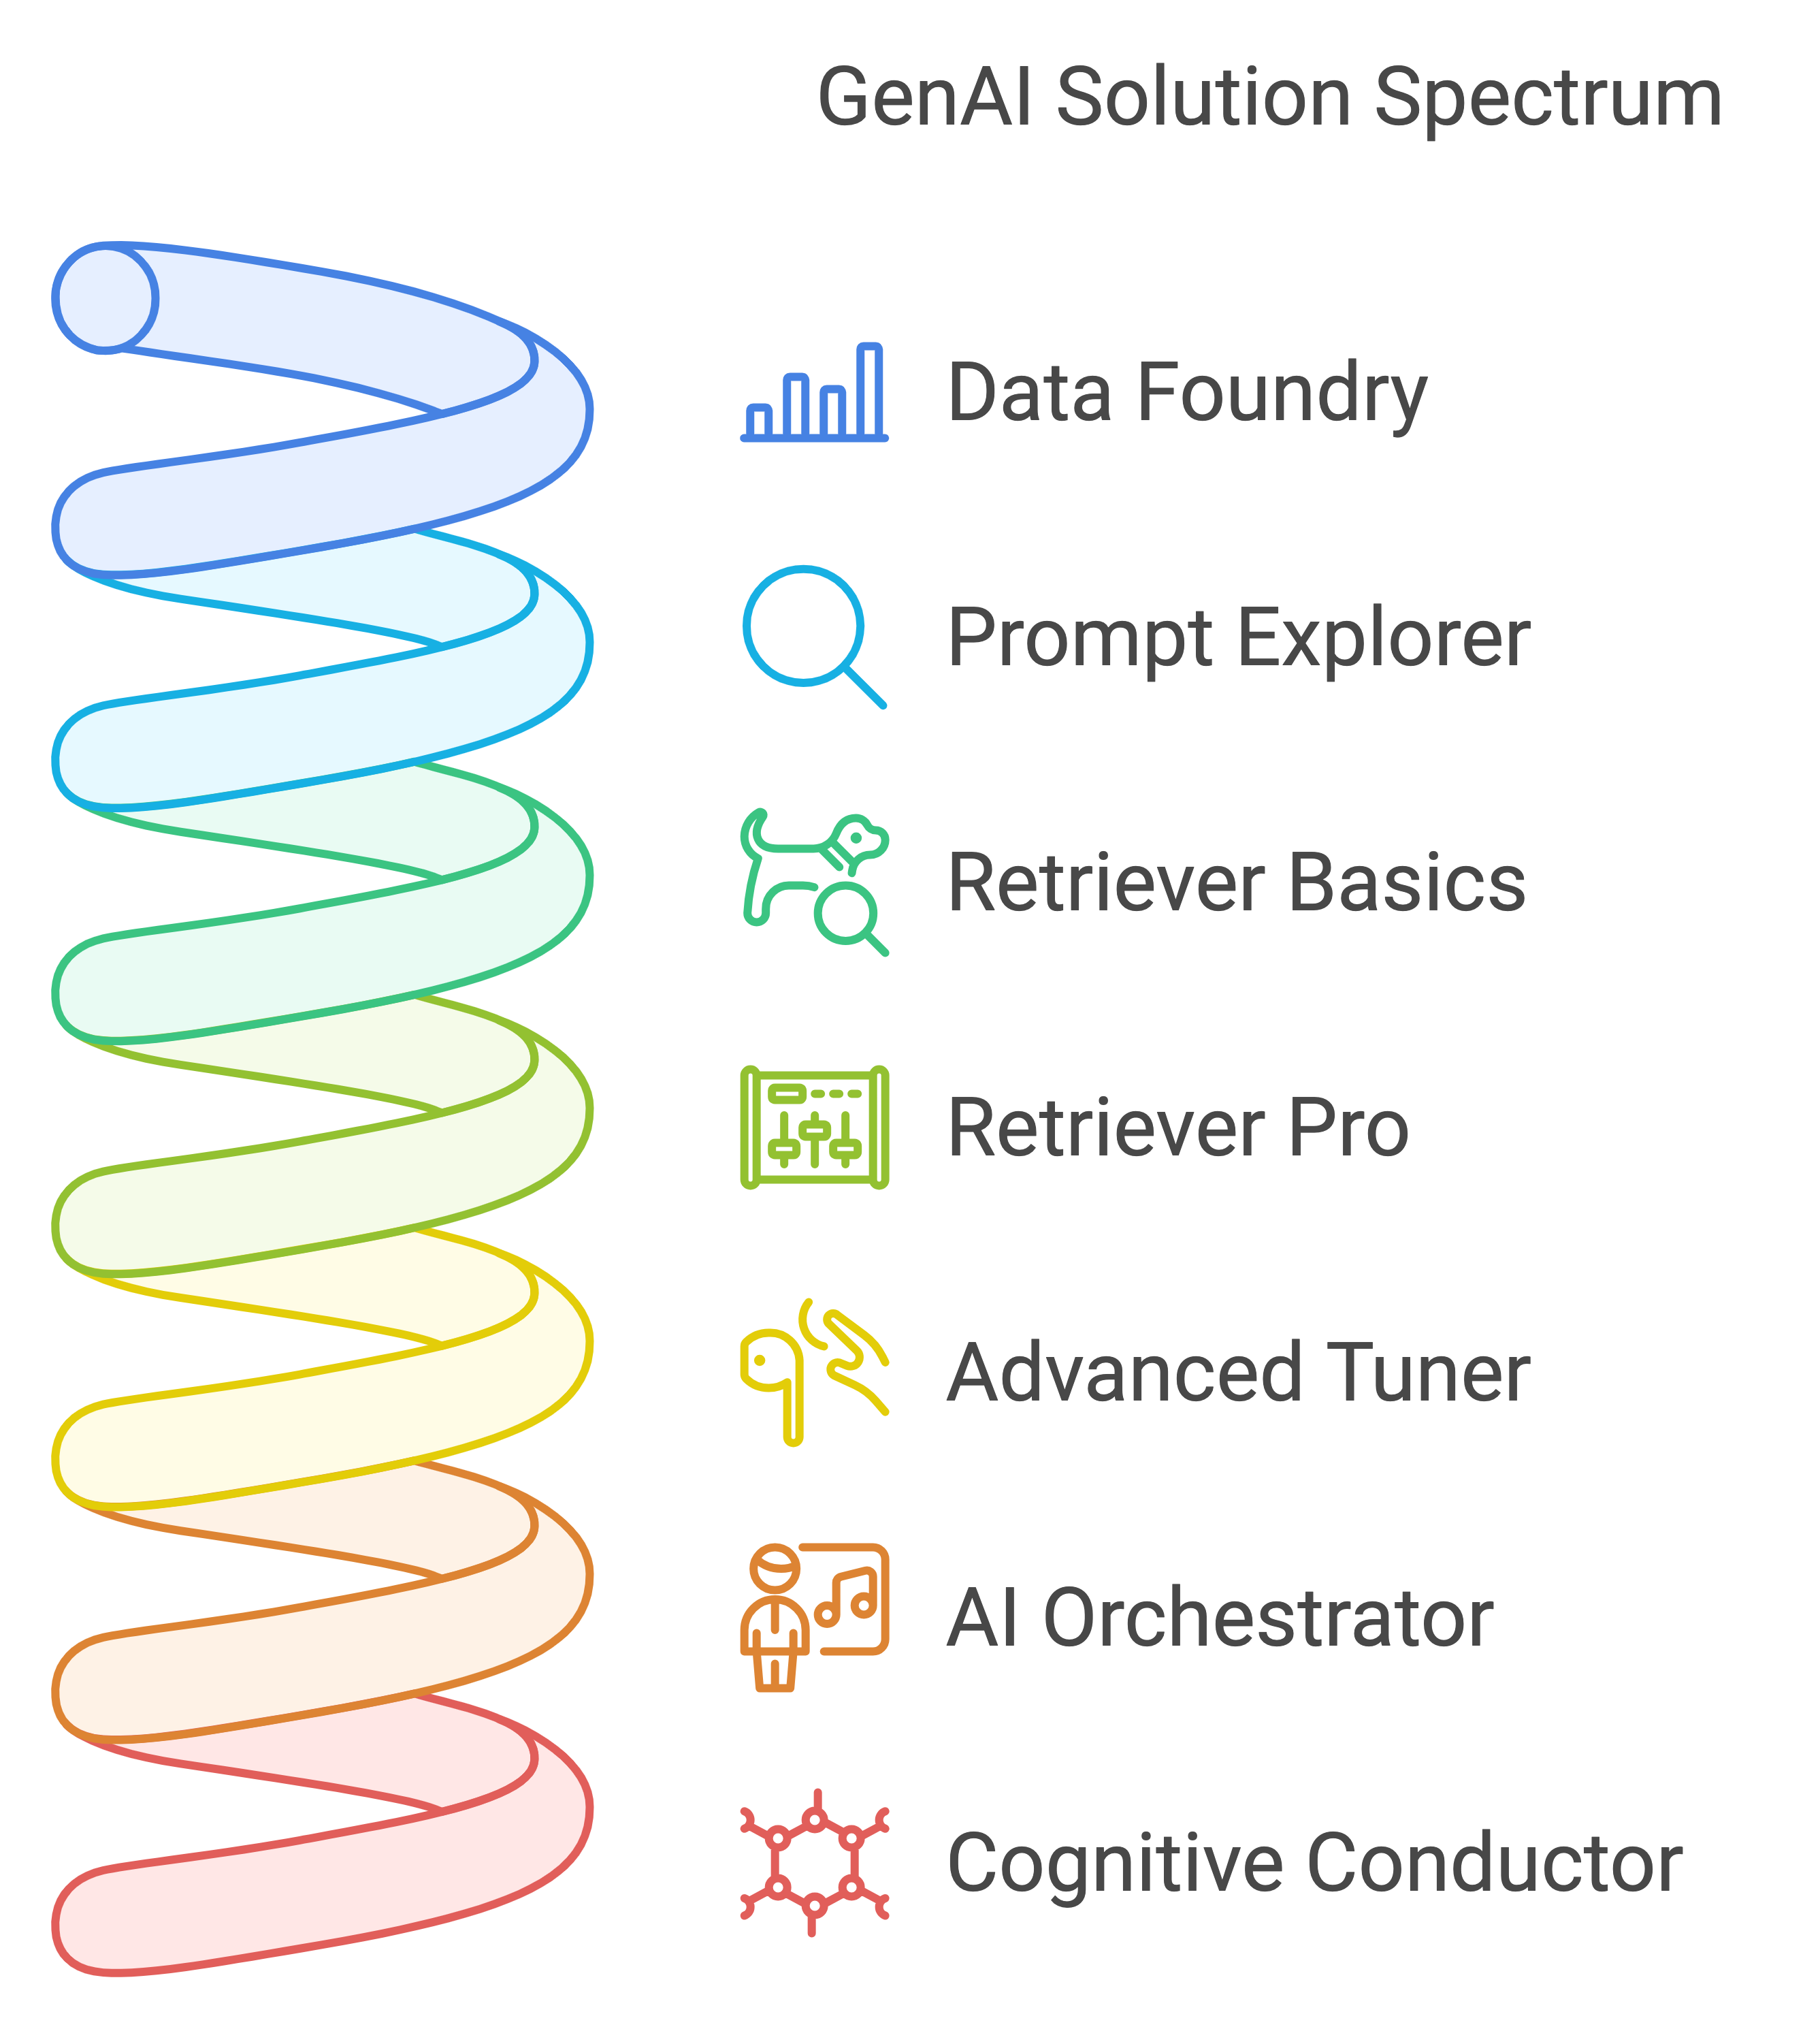
The GenAI Maturity Landscape: A Journey of Evolution

Slide 13
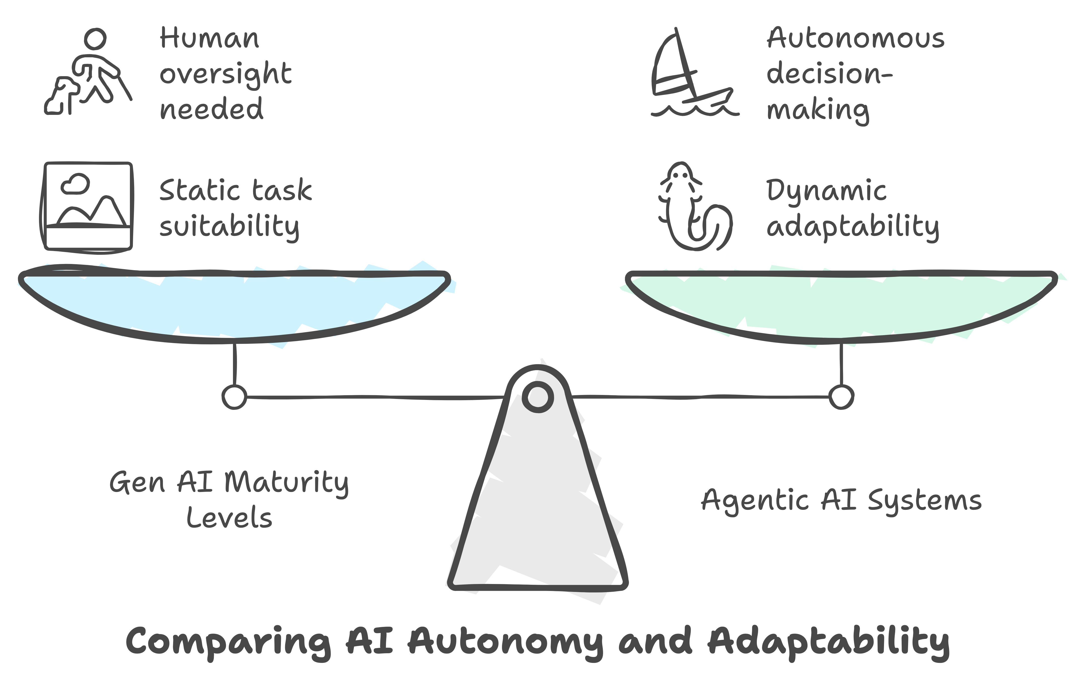
What Agentic Systems bring into table

Slide 14
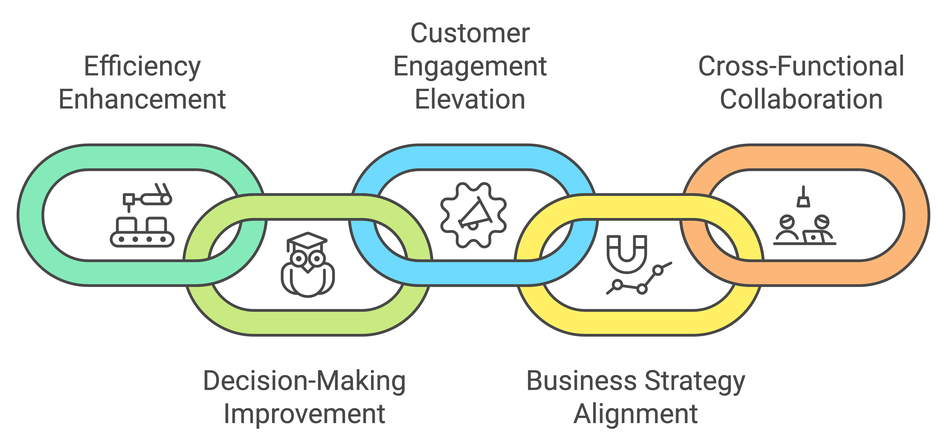
Agent Deployment Strategy
Notes:
1. Establish Specific Goals for AI Agent Deployment
Enhancing Efficiency: Identify processes that are repetitive or time-consuming where AI agents can automate tasks, leading to increased operational efficiency.
Improving Decision-Making: Utilize AI agents to analyze large datasets and provide insights, thereby supporting more informed and timely business decisions.
Elevating Customer Engagement: Deploy AI agents to offer personalized customer interactions, improving satisfaction and fostering loyalty.
2. Align AI Initiatives with Overarching Business Strategies
Integration with Business Objectives: Ensure that AI projects are directly connected to the organization's key priorities, such as revenue growth, market expansion, or innovation.
Cross-Functional Collaboration: Engage stakeholders from various departments to align AI initiatives with diverse business needs and to facilitate seamless integration.
Continuous Evaluation: Regularly assess the impact of AI deployments on business outcomes and adjust strategies as necessary to maintain alignment with evolving business goals.

Slide 15
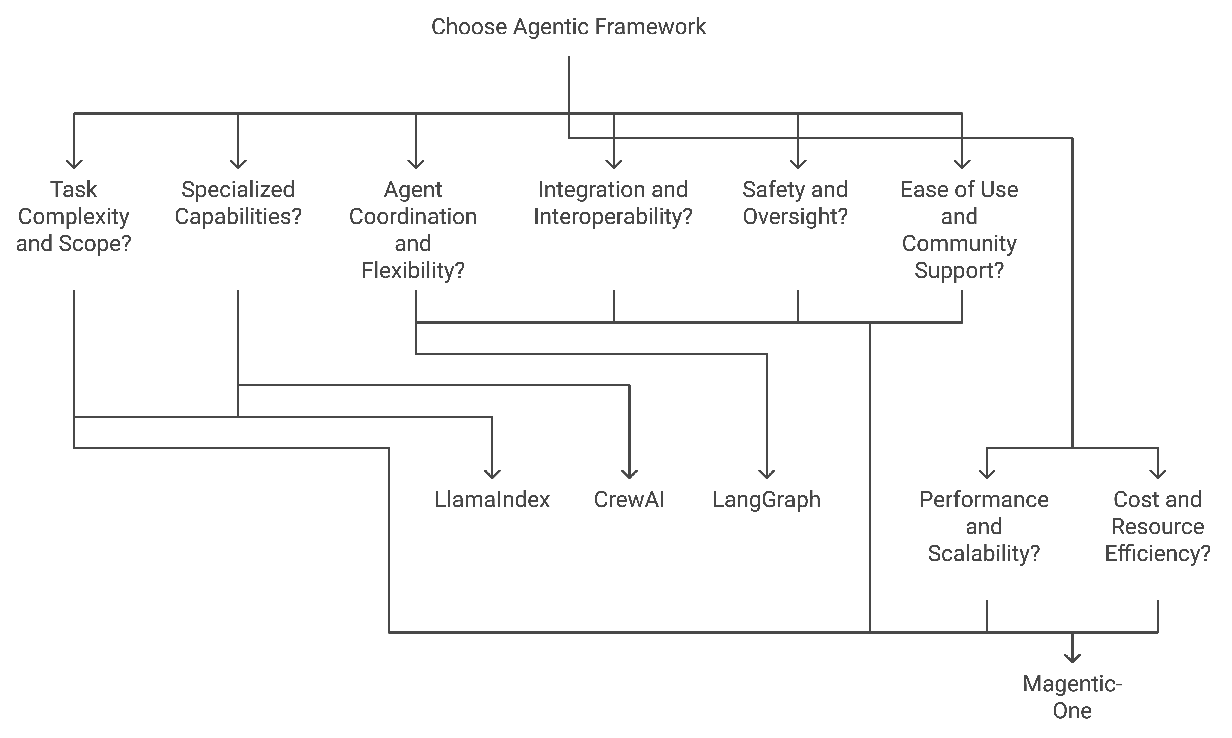
Agent Framework Decision criteria
Notes:
AI Agent for everyone series
https://www.linkedin.com/pulse/ai-agent-everyone-part-5-magentic-one-multi-agent-tasks-govindaraj-71ryc/?trackingId=9DE0cNvgqOYhwG8EDeNrvw%3D%3D
AI Agent for Everyone - Part 4 OpenAI Swam
AI Agent for everyone - Part 3
AI Agent for everyone - Part 2
AI Agent for everyone - Part 1

Slide 16
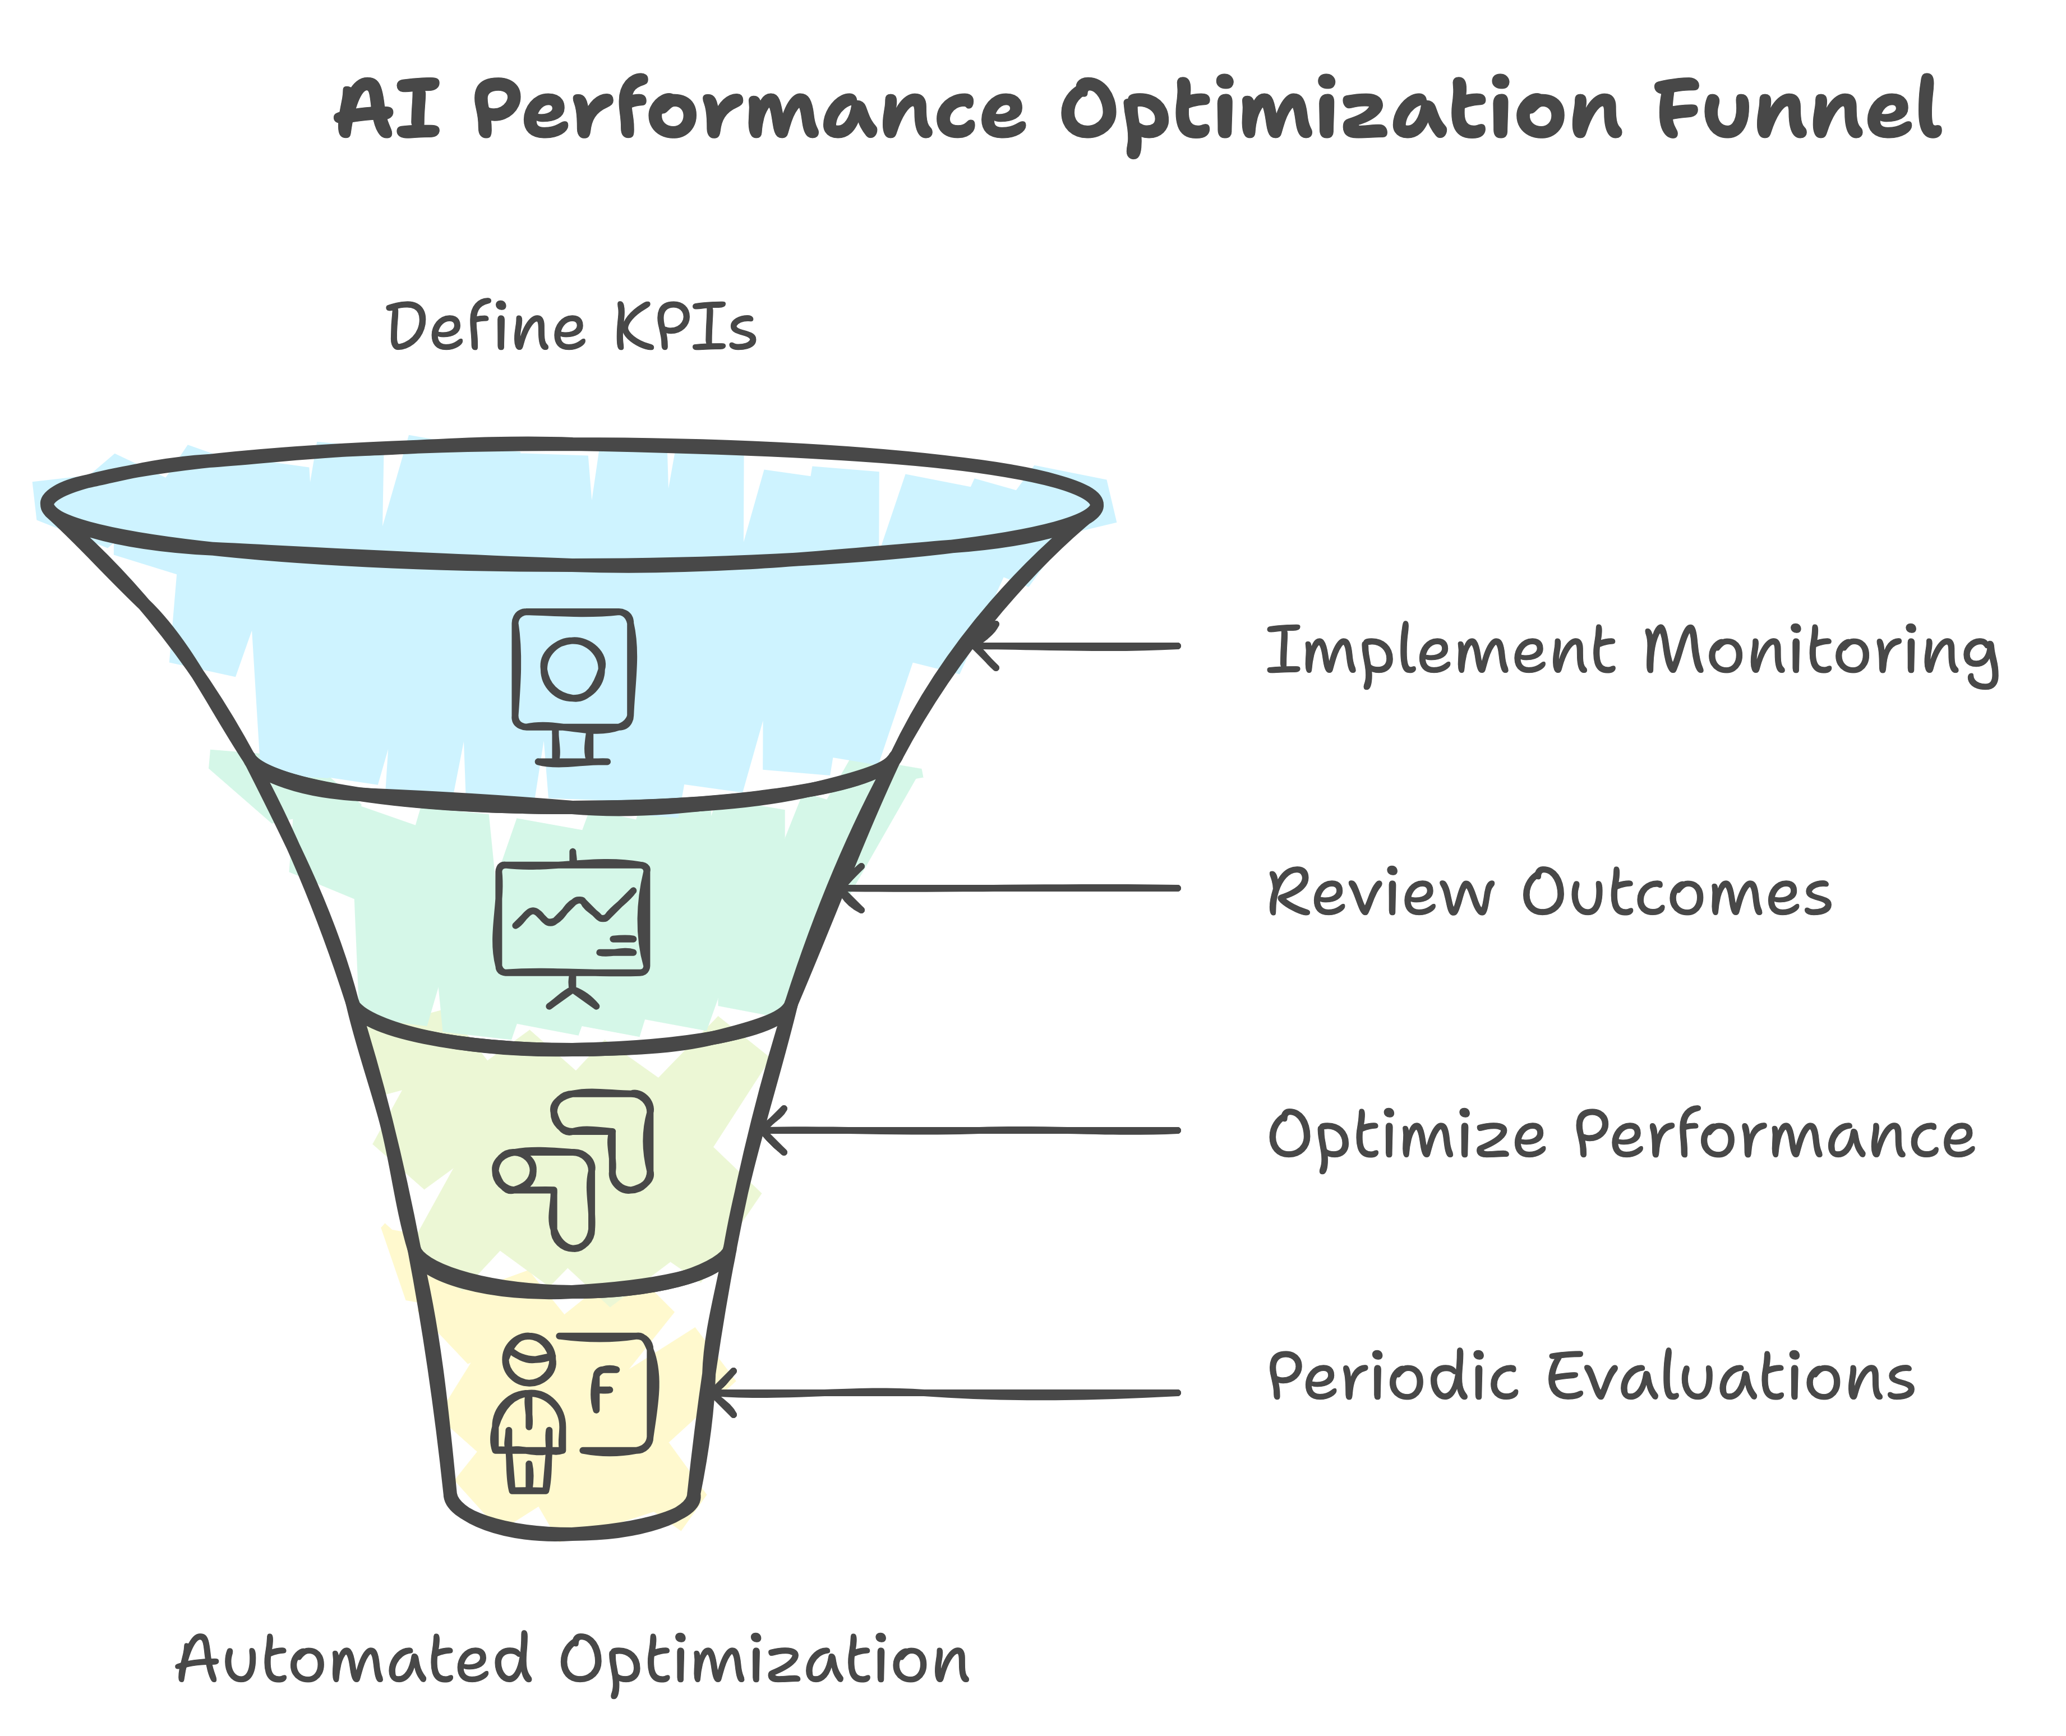
Agent Optimization Funnel

Slide 17
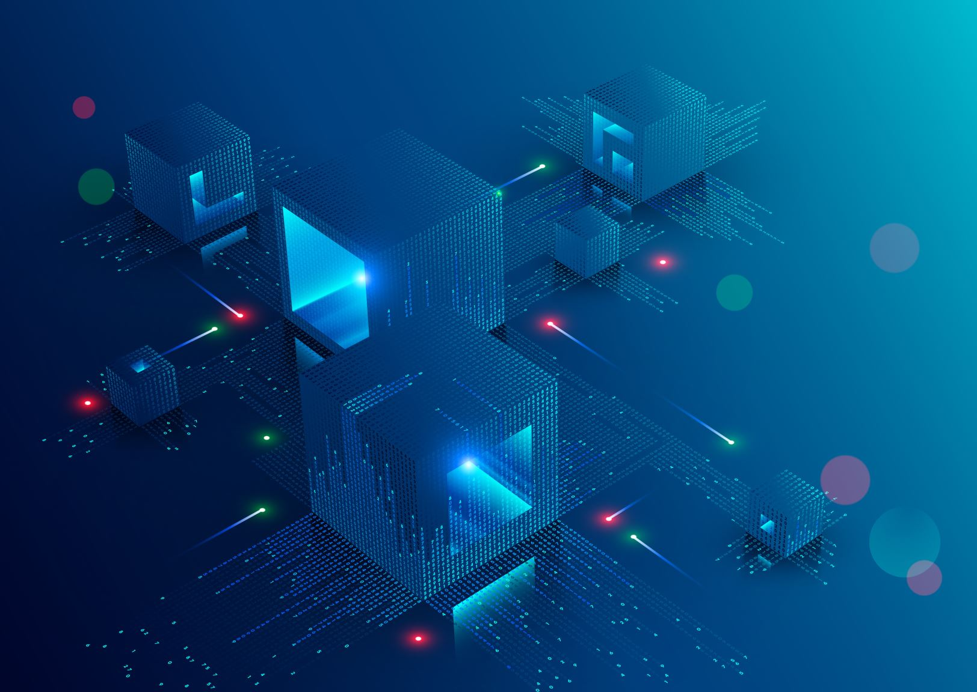
AgentOps
Emergence of AgentOps
Definition: AgentOps, inspired by DevOps/MLOps, is an end-to-end platform designed for managing the development, deployment, monitoring, and observability of autonomous AI agents.
Objective: To enhance the reliability and observability of Foundation Model (FM)-based autonomous agents.

Slide 18
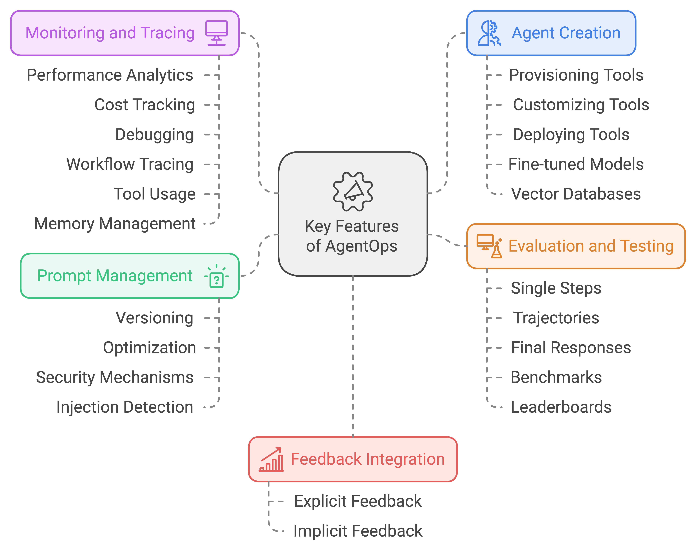
AgentOps Capability

Slide 19

Take away
Glimpse of GenAI Solution
AI Maturity Assessment
Agent Architecture capability
AgentOps Optimization & Capability

Slide 20

Thank you

Slide 21
Presentation materials

Slide 22

Appendix

Slide 23

Reference
AgentOps - https://arxiv.org/abs/2411.05285v1

